Slide 1

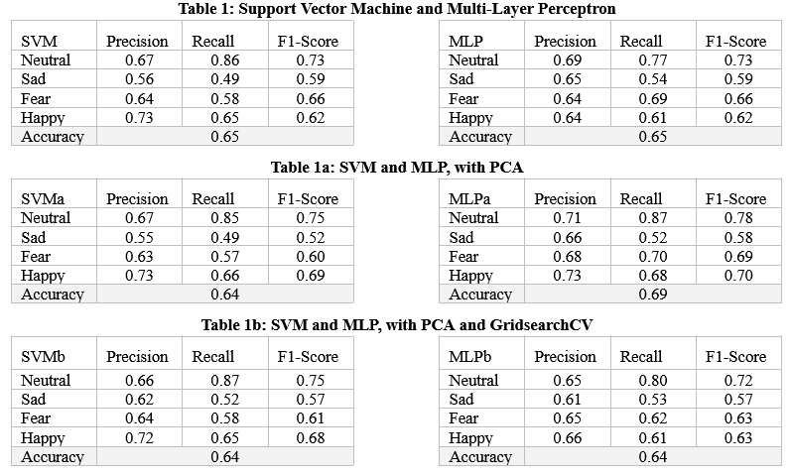
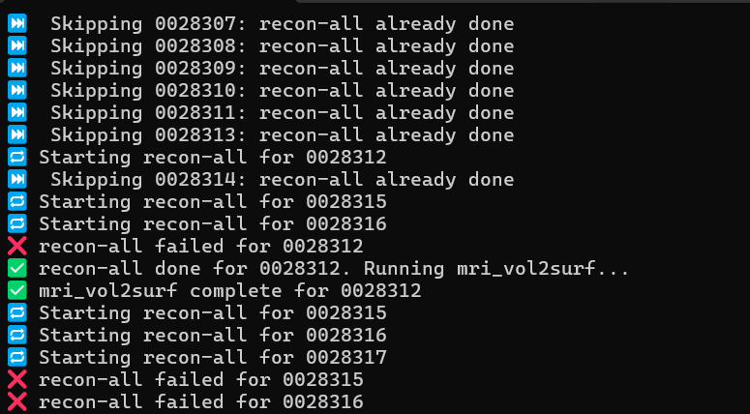
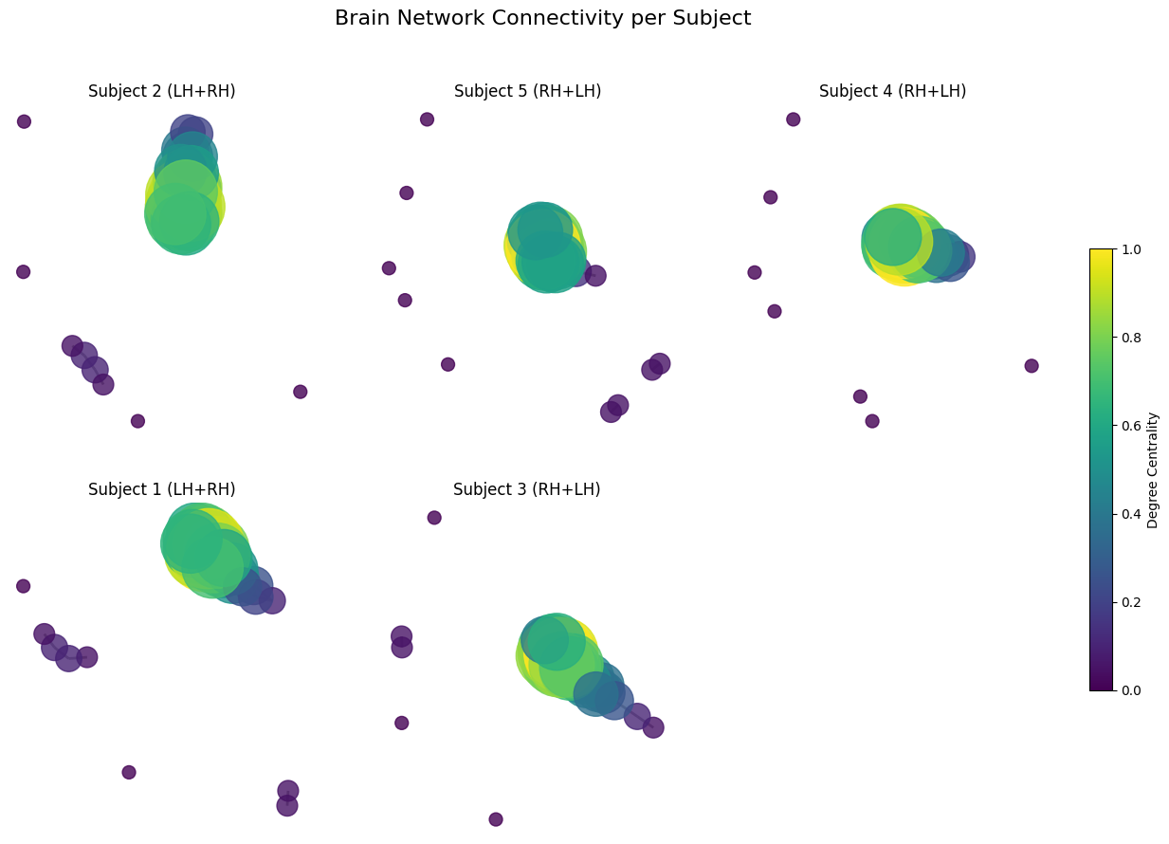
Feature processing pipeline for EEG and fmri analysis
Joshua Green, Bach Nguyen
EEG Results
Introduction
This project proposes a hybrid machine learning approach to detect and classify emotional states from EEG signals and fMRI images.
EEG Dataset
The study used 32-channel EEG data from 15 subjects exposed to emotional film clips across three sessions. After preprocessing, key spectral features were analyzed to study neural patterns linked to emotions.
FMRI Dataset
Develop a brain-wide, high-dimensional multivariate classification pipeline for decoding and localizing psychological states (visual and socio-affective) using fMRI data.
Like 0028312, we are finishing up just in time!
Methodology
Discussion
EEG Predictions
Support Vector Machine (SVM)
Multi-Layer Perceptron (MLP)
w/ Principal Component Analysis (PCA)
w/ Grid Search
t-distributed Stochastic Neighbor Embedding (t-SNE)
t-SNE projection with K-Means Clustering
FMRI Data Processing
Principal Component Analysis (PCA)
Random-forest for feature importance
Graph-theoretical metrics for clustering
Conclusion
Multimodal approach effectively revealed emotion-based clustering in EEG and fMRIs.
Strong emotions (happy, sad) showed clearer separability than neutral.
Next Steps
Long Short-Term Memory (LSTM) modeling.
Advance toward dynamic emotion modeling across neural data modalities.
References:
[1] Wei-Long Zheng, Wei Liu, Yifei Lu, Bao-Liang Lu, and Andrzej Cichocki, EmotionMeter: A Multimodal Framework for Recognizing Human Emotions. IEEE Transactions on Cybernetics, Volume: 49, Issue: 3, March 2019, Pages: 1110-1122, DOI: 10.1109/TCYB.2018.2797176.

Slide 2

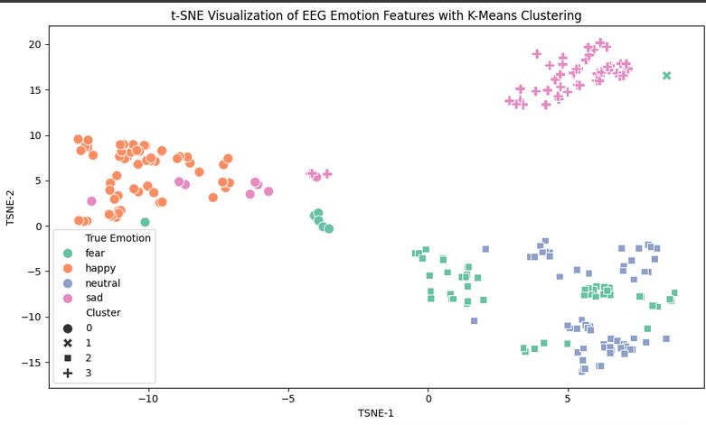
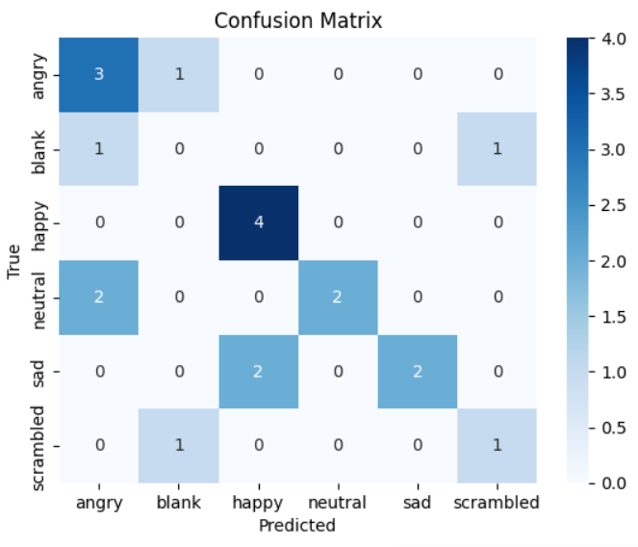
Emotion Classification Research Poster
Unsupervised Learning Results
t-SNE Plot (EEG): Distinct clusters can be observed for each emotion (happy, fear, neutral, sad). Emotions like happy and sad are particularly well-separated in feature space, indicating strong emotional signatures.
Confusion Matrix (fMRI): The model performs well at identifying certain emotions like happy (perfect classification: 4/4) and sad (correctly predicted 2 out of 4), again suggesting these emotions are well-separated in the fMRI signal space as well.

